Slide 1
Introvert's journey to agility
By Arati Joshi
Notes:
Name
Topic
Greet the audience

Slide 2

Come out of comfort zone
Notes:
Tell story of two birds and moral of the story
Waterfall to agile team transition for me was like this bird. I had to come out of my comfort zone.

Slide 3

Waterfall Team
Notes:
Explain typical day for software engineer on waterfall team
I was in my comfort zone where I would not feel the need to talk to many people to complete the work.

Slide 4
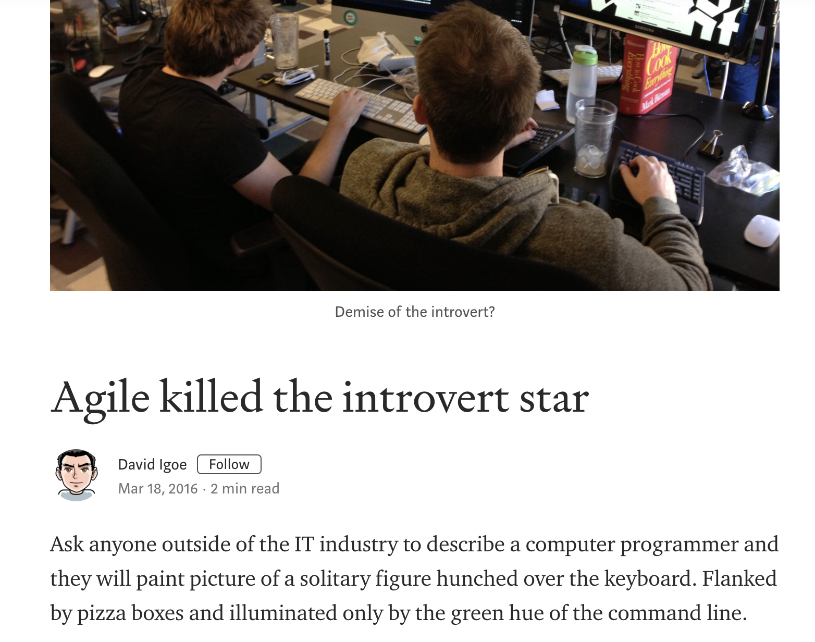
Agile Team
Notes:
Explain typical day at work for Software engineer in agile team
The constant interactions with someone on the team was causing overload and stress.

Slide 5
Collaboration is backbone of agility
Individuals and interactions over processes and tools
Customer collaboration over contract negotiation
Business people and developers must work together daily throughout the project.
The most efficient and effective method of conveying information to and within a development team is face-to-face conversation.
At regular intervals, the team reflects on how to become more effective, then tunes and adjusts its behavior accordingly.
Notes:
Talk about key principles and values from agile manifesto.
Point here is, agile manifesto also suggests collaboration is backbone of agility. Better team members are at working with each other, higher the success of agile teams.

Slide 6
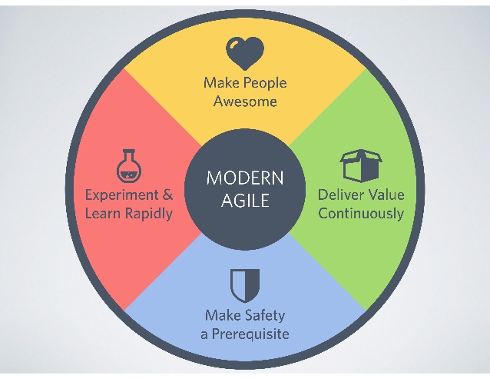
Collaboration makes people awesome
Notes:
Explain what make people awesome principle means
On my team we were bringing in practices like paired programming, mob programming, test driven development, CI, CD. These practices and concepts were new. We all were working and learning together in order to bring about this change. We used to work in groups for entirety of the time we used to be in office. This was helping with better product.

Slide 7
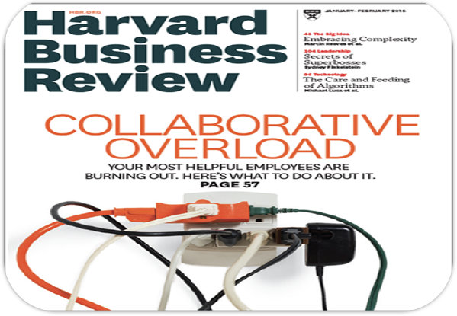
More collaboration = More overload
Notes:
But was also causing more overload.
Explain what HBR has to say about collaborative overload.
Discuss introversion extroversion spectrum
Discuss how traits and problems of introverts are going to be applicable for more than just introverts
Make a point that being an introvert and after observing other introverts around me I recognized these type of problems are more prevalent in introverts than those of others

Slide 8
What are we going to learn?
1. What is introversion
2. How to identify introverts on your team
3. Problems introverts face at workplace
4. What can introverts do about it
Notes:
Goal is to understand how can introverts be better collaborators and be part of awesome team
Problems are common because introversion occurs on a spectrum

Slide 9

What is introversion?
Book quiet
Notes:
Describe the situation where I used to get tired by end of the day with constant interactions
About Susan and her book and her work
I learned that there are more like me. We are introverts. We need more solitude and quiet for recharging our brains.

Slide 10
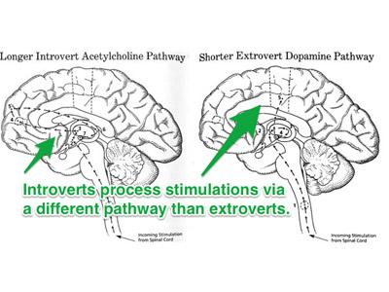
Introverts and brain science
Notes:
Why introverts are like this?
Simple vs Complex neural pathways
Dopamine vs Acetylchloline

Slide 11
What can introverts do about this?
Notes:
Strategies might be disappointing, because people are looking for formulas in modern world.
For making space in modern workplaces, introverts need to change behavior.
I do not mean act in extroverted ways
Tell about Free Trait Theory - Brian Little
Behaviour change is going to be required in small steps, and we are going to learn how introverts can do this by changing the perspective

Slide 12
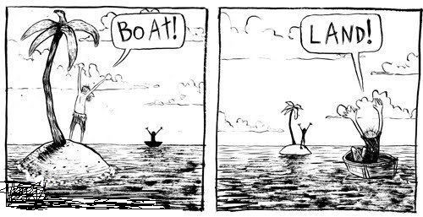
Change perspective
Notes:
Change perspective husband wife story
Introverts need to change perspectives and look at more positive traits
Stepping out of comfort zone is not easy. Biology does not support it, society has not promoted it, work environments are not well equipped. In spite of that if we consider changing perspective towards looking at things and bring in more positive aspects of introversion into consideration then we can be better communicators.

Slide 13
Introversion is not a personality flaw….
It is a challenge, once you accept it, you will free yourself of guilt of needing a quiet time to recharge.

Slide 14

Mysterious people
Notes:
Handle some complicated situations patiently
Sometimes have irritating expressions on face
Can’t tell when to approach them
Colocation takes a toll. You start pairing, and colleague comes to check with a query
You start mobbing, and someone from other team who is taking a break wants to hang out
You start white boarding and other team members chime in with their idea
Someone taking calls for their work
Introverts need, quiet, uninterrupted time for completing work or learning new stuff. It is hard to find at such workplaces

Slide 15


Create solitude
-
Notes:
Instead of thinking of fitting in CHANGE PERSPECTIVE, think about creating space for yourself
Build quiet time in your schedule with regular walks, visit to nature, reserved meditation rooms
My colleague used to play piano

Slide 16

Brain + Storming
Sudden Attack on brain
Notes:
Brain storming is like sudden attack
Ideas flow around, people are getting excited, but introverts are quiet
Blank expression story

Slide 17

Do you feel you are slow?
Notes:
- CHANGE PERSPECTIVE by thinking i don't have to come up with ideas right now
- how about sending ideas the next day?
- speak up ideas even when you feel ship has sailed, you are building a communication muscle.
- communication is a muscle - share how GOTR introverted girls do not get chance to talk. Our society and education system unfortunately has given enough alone time and chances t introverts as we were growing up. That is why our communication muscle is not very strong. At every opportunity we need to look for giving it an exercise.

Slide 18

Pairing and mobbing causes stimulation?
Notes:
- CHANGE PERSPECTIVE by thinking this provides accelerated learning
- Take more breaks
- express the needs of being alone
- strict pairing techniques and externalizing opinions
- pair for half day

Slide 19
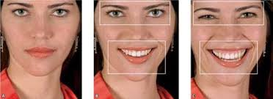
Duchenne smile
Notes:
- someone called me people repeller
- chinese girl would say to look more approachable when you smile
- go for the Dutchenne smile

Slide 20

Feeling Drained?
Notes:
- CHANGE PERSPECTIVE by thinking how can i save what i have?
- clear workplaces
- clean brain clutter

Slide 21
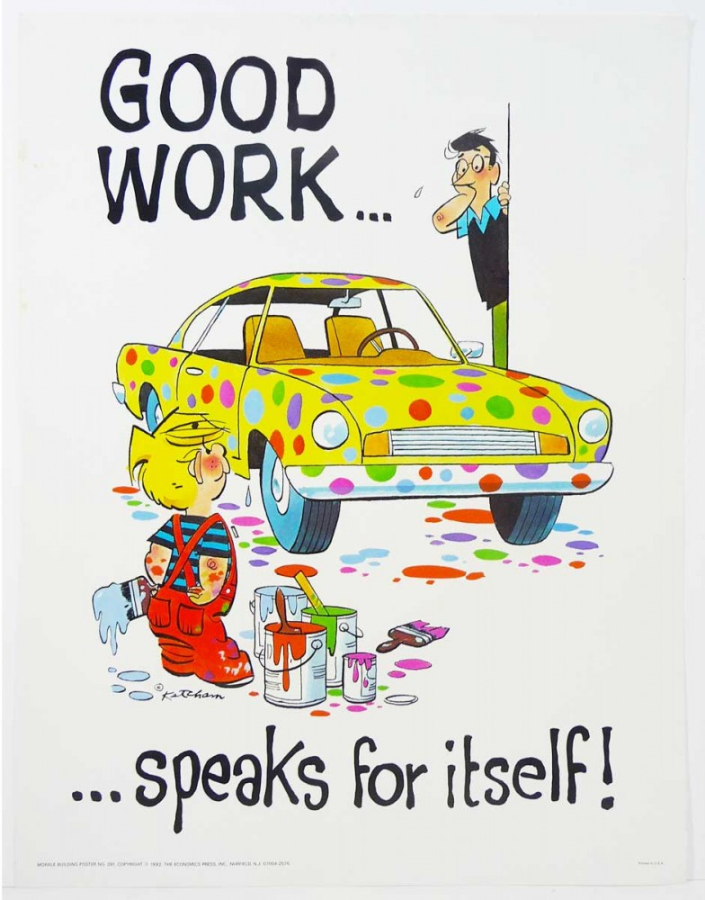
Toot your horn!!
What? Why?
Notes:
Most stressful times is performance reviews
They like to work speak for itself
Introverts are very uncomfortable sharing ideas on open platform, just because they have not done anything like this before
Consider sharing your ideas by bringing them up in front of audiences.

Slide 22
Different take on networking
Notes:
CHANGE PERSPECTIVE by thinking presenting your ideas is taking different take on networking

Slide 23
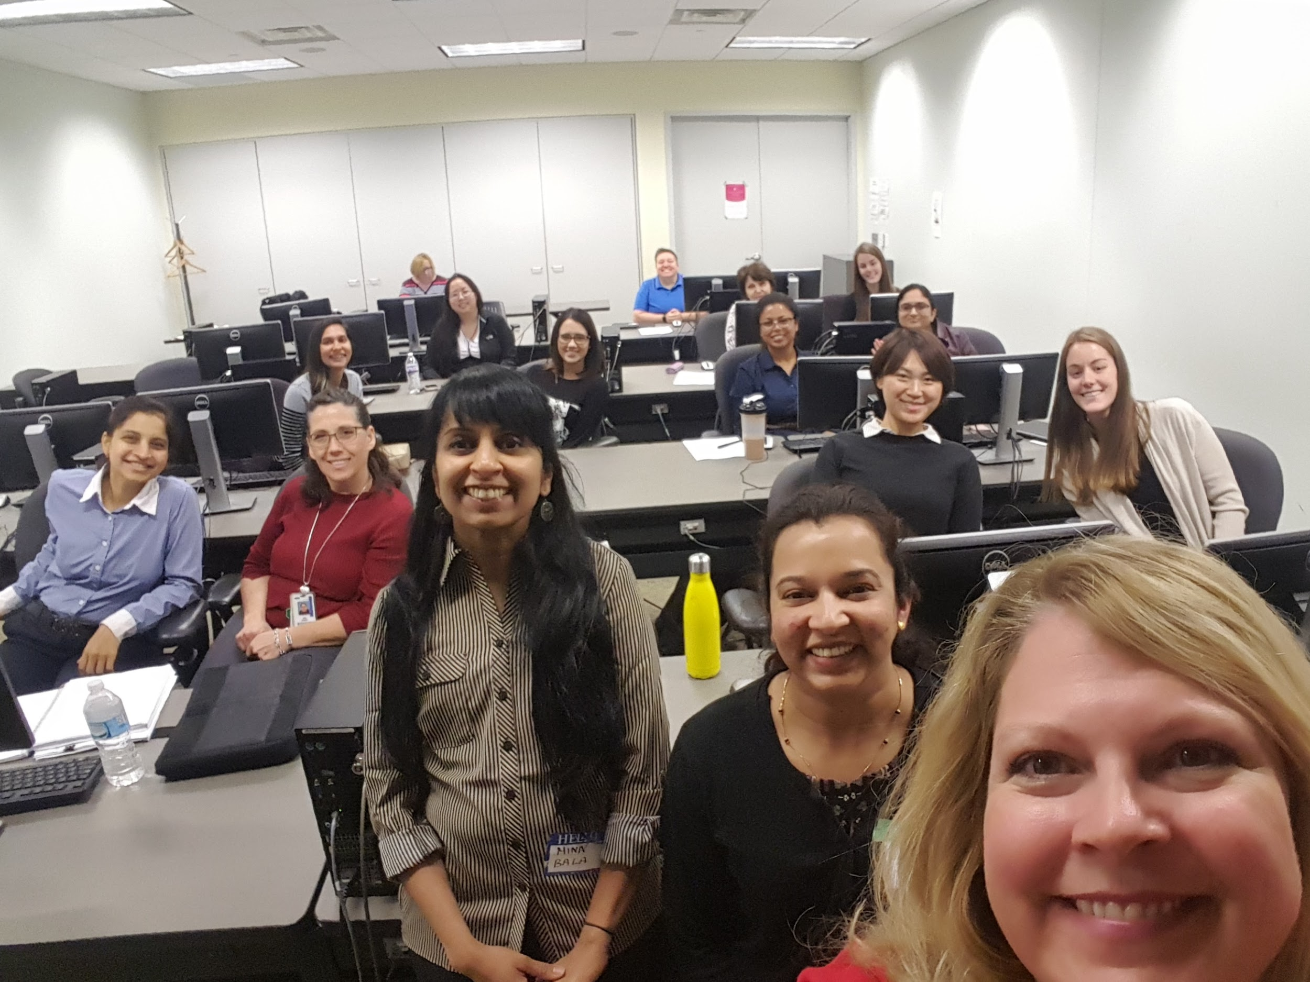
Take Small step
Notes:
- Taking workshops where there were familiar faces and people who you can relate to helps

Slide 24

Take one more step!!
Notes:
- Started speaking at meetup groups, and got more feedback about work and ideas and more ideas to piggyback upon
- At meetup groups, I have my fallback plan. It is just that I am on the stage

Slide 25
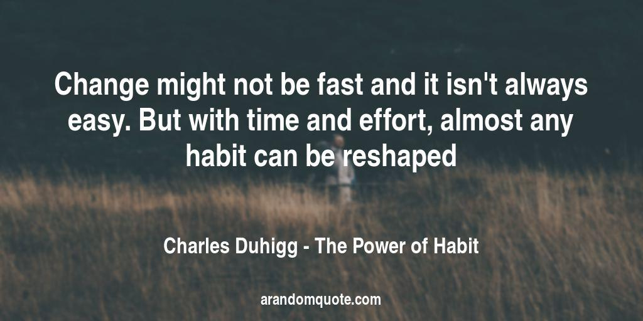
Notes:
Introverts have to do this delicate dance of trying to change their habits with changing work culture, at the same time maintain the needs. It is going to be hard and it is going to take time. But small steps consistency and letting go helps.

Slide 26
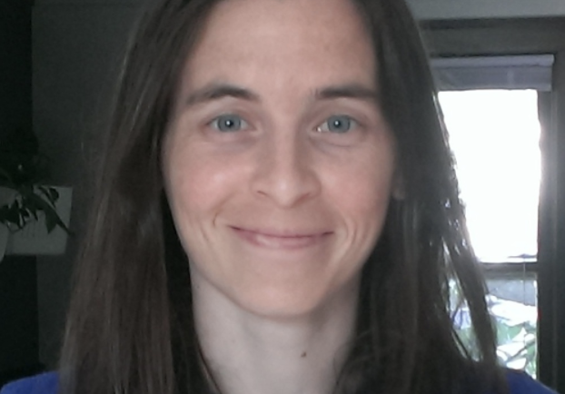






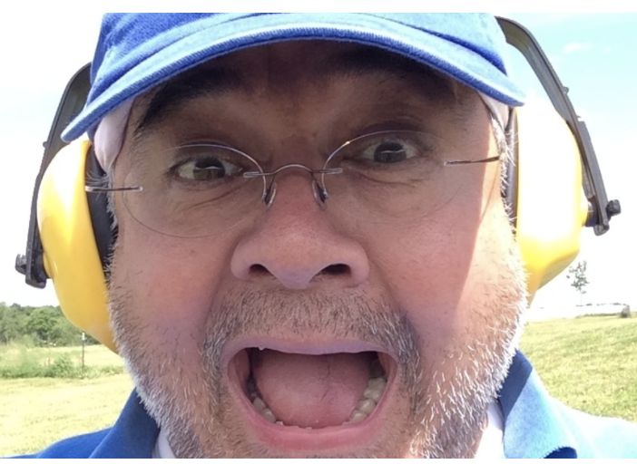

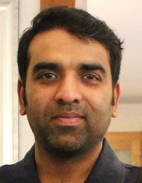
Notes:
people who helped me through my journey were these very supportive and encouraging team members. If there is anything that you are taking out of this presentation is this..if you are an introvert then open yourself up and let the world understand you and your ideas. Be more interested in growth than in comfort. That way you get to be awesome while being part of the awesome teams.
If you are not an introvert then consider identifying those on your team and help them if they are struggling with same issues as I did.
Because together we make awesome teams and awesome teams make better products.

Slide 27
Arati Joshi
Email - joshi.arati.12@gmail.com
LinkedIn - www.linkedin.com/in/arati-joshi-123
Twitter - https://twitter.com/aratister

